Slide 1
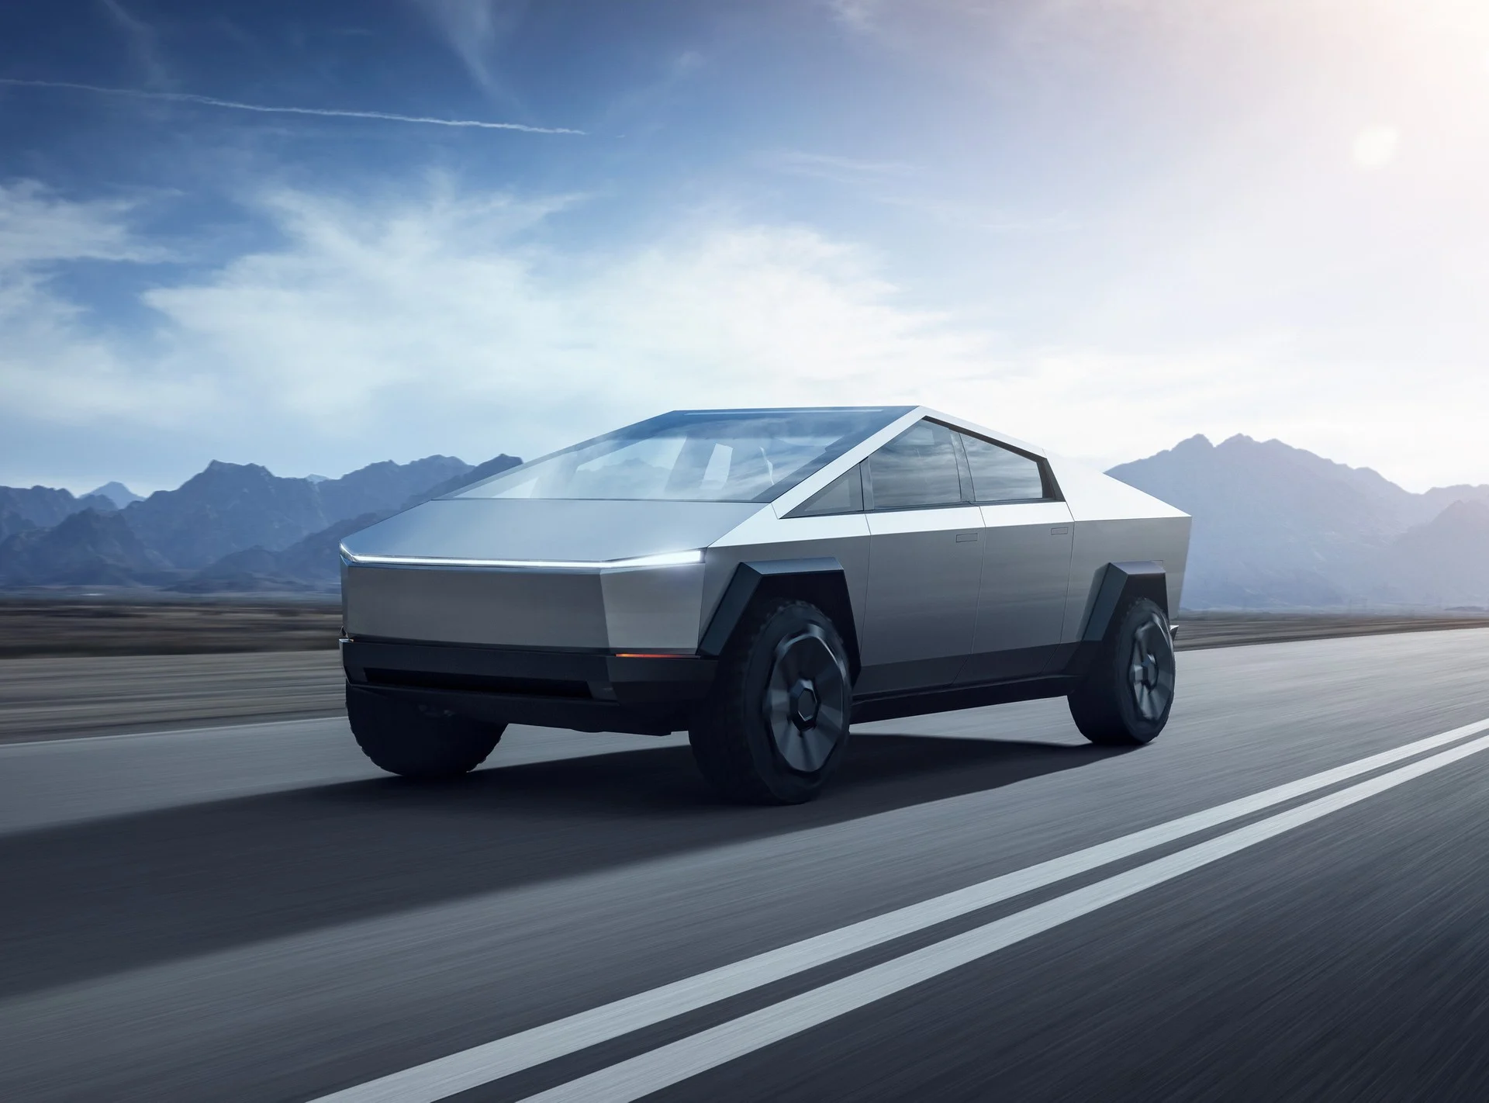
Smart Autonomous Electric Vehicle
(SAEV)

Slide 2
Supervised by: DR. Essam Nabil :Team Members ❶Nourhan Mohammed Negm ❷Youstina Atef Salama Salieb ❸Aya Basuony Elgarhy ❹Kyrillos Alaa RezK ❺Halim Nader Halim Habib

Slide 3
Outline of presentation
01
02
03
04
05
System design
Implementations
Overview ABOUT THE PROJECT
Trainning and Testing
Results and Future Work

Slide 4
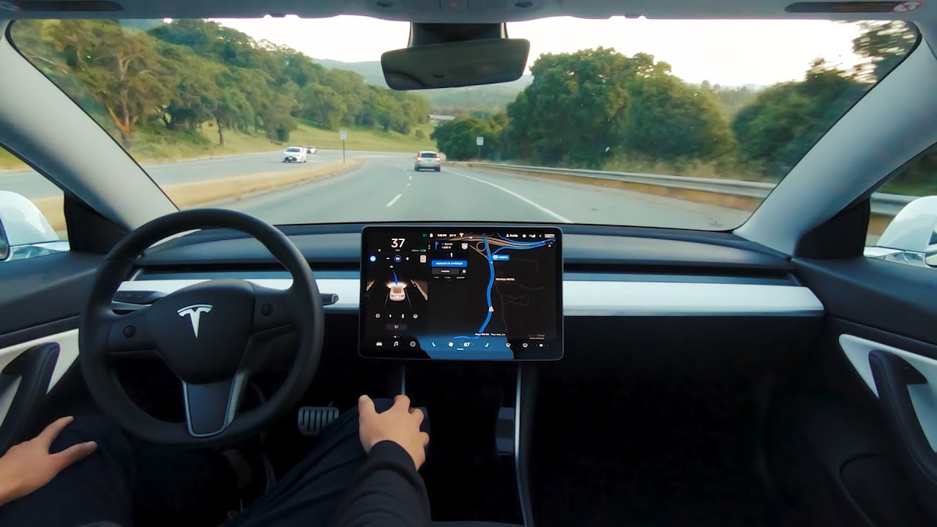
01
Overview

Slide 5
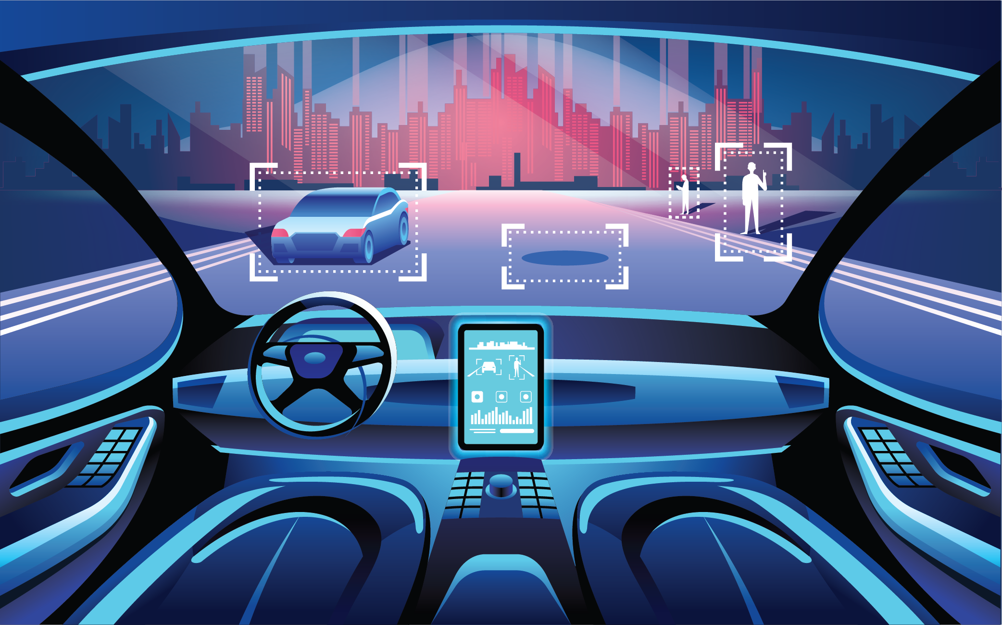
Autonomous electric vehicles (A-VE)
self-driving vehicles powered by electricity.
These vehicles use sensors and computer vision to navigate.
A-EVs are capable of driving where traditional cars and human drivers do.

Slide 6
—
A human passenger is not required to take control of the vehicle at any time, nor is a human passenger required to be present in the vehicle at all.
(SAEV)

Slide 7
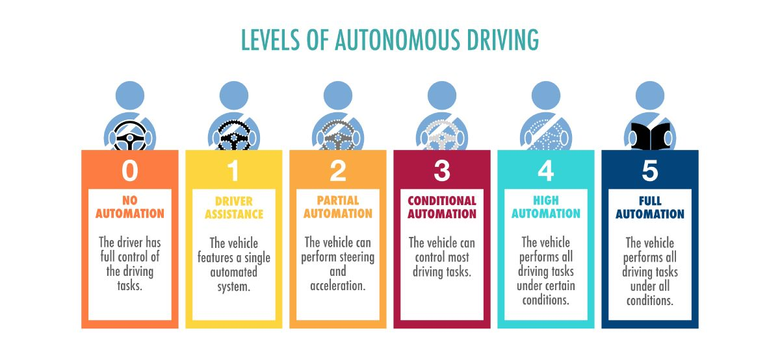

Slide 8
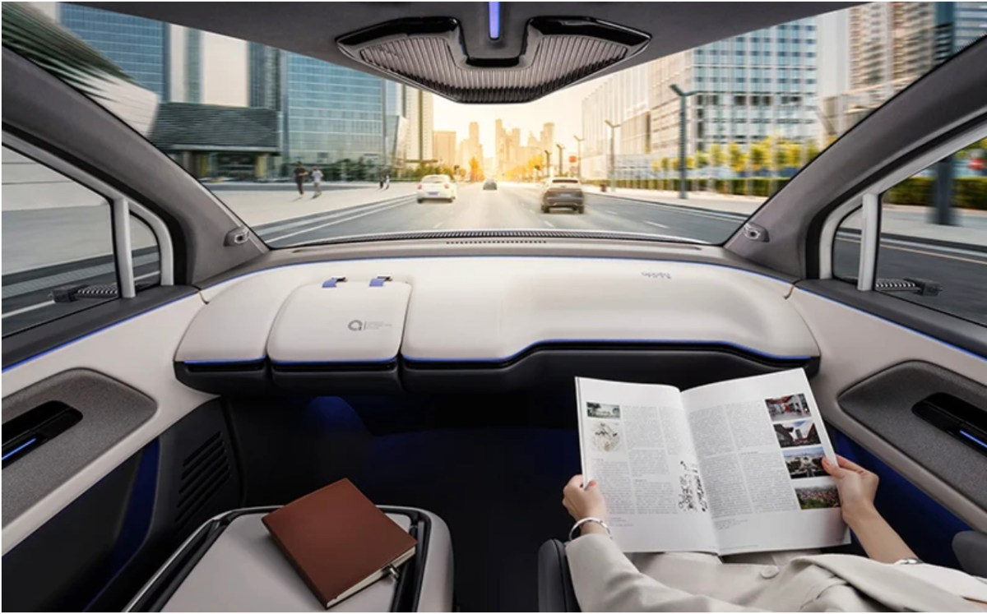
Problem Statement
who cannot drive; perhaps as they are underage, have no driving license
occurrence of traffic accidents
weather conditions and dangerous roads that humans cannot deal with
People can do work in autonomous vehicles, increase working efficiency

Slide 9
proposed solution
01
02
03
A camera, to analyze the environment
An algorithm to solve different tasks such as line tracking ,sign detection
Artificial intelligence and machine learning system to solve the unpredictable situations

Slide 10
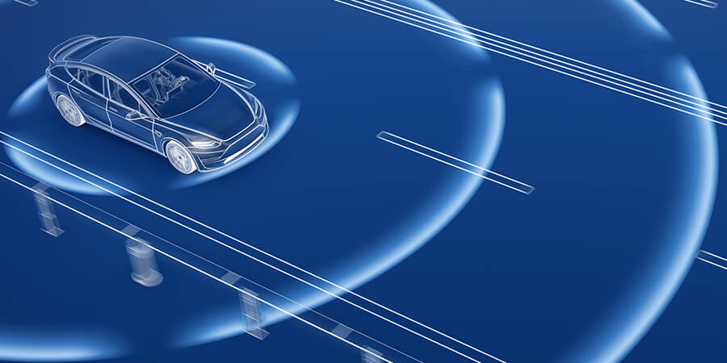
objectives
A car which is capable of understanding and processing the
surrounding environment
to remove the need of human
intervention with automatic decision-making system
make sure that the control system for an autonomous car ensures safety regardless of human unpredictability
some companies have turned to Self-driving vehicles by using sensors to sense and driving safely

Slide 11
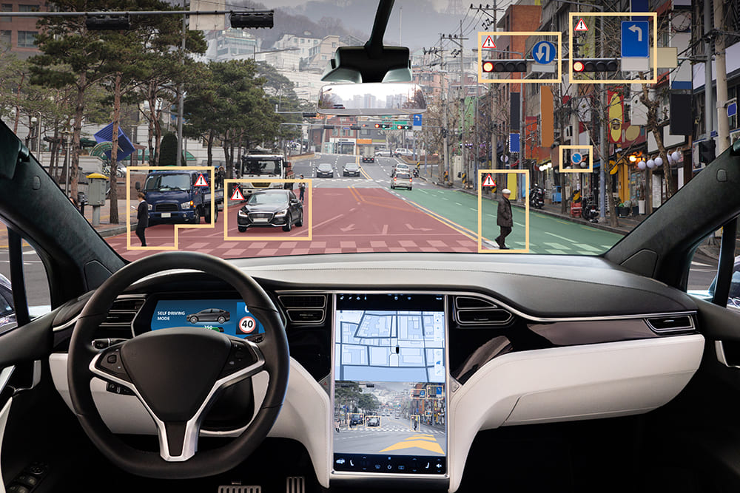
Environment processing

Slide 12
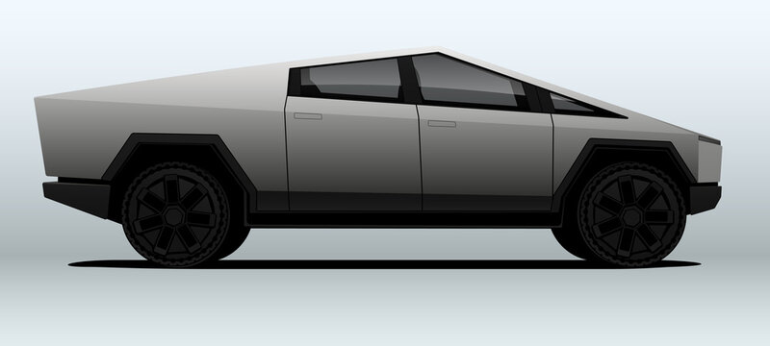
SYSTEM DESIGN
02

Slide 13
Requirements and Specification Analysis
The autonomous car can path a route surrounded by white lanes and recognize signs, traffic light, or objects and interact with them.
Fourth primary devices are used: the Raspberry pi, the raspberry pi camera v2, the motor driver connected to 4 dc motors and Arduino uno.

Slide 14
System Architecture
Action Module
Vision and computing module
User Control module

Slide 15
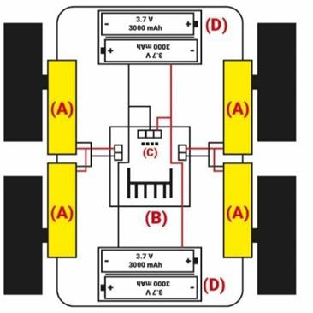
Action Module
It is an embedded hardware system
This module is the responsible one for giving movement to the autonomous robot.

Slide 16
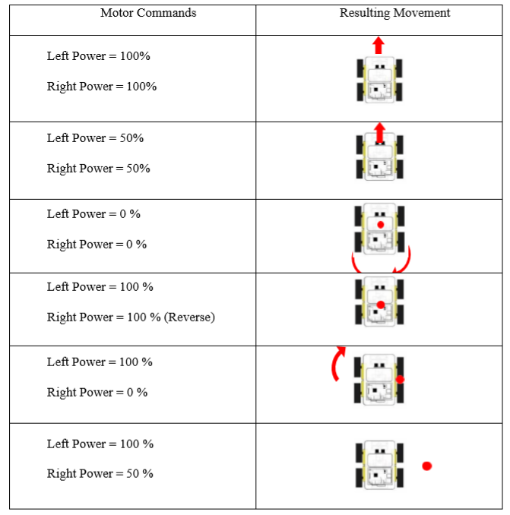
Moving the car depends on the power applied to each side left and right

Slide 17
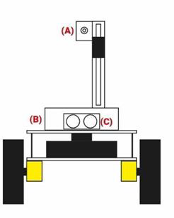
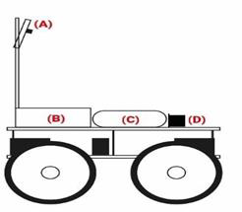
Vision Module
Embedded in the Raspberry pi system
It is responsible for interpreting the scene using an image, detecting the obstacles, and generating paths

Slide 18
Sub modules of vision module
Image Acquisition
Lane lines detection
Object Detection

Slide 19
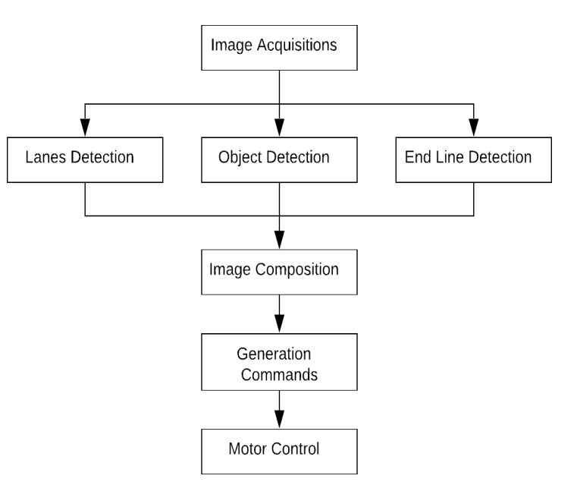

Slide 20
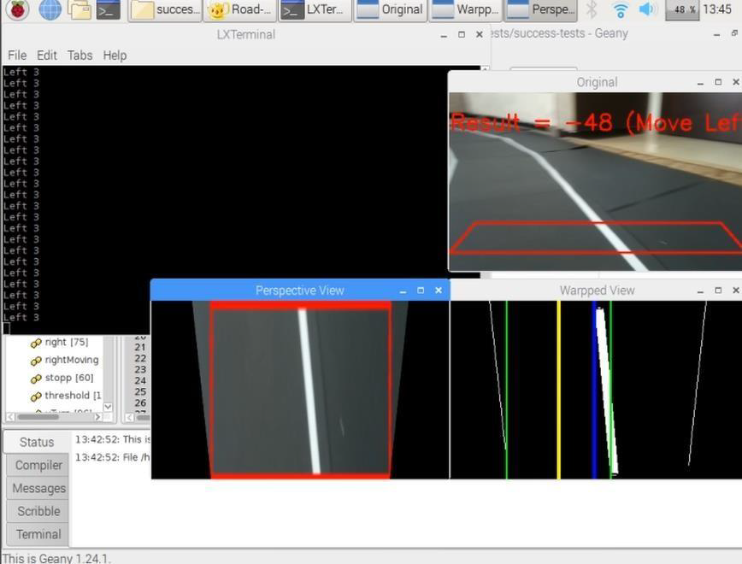
Control Module
to able to control the entire system and to see what the raspberry pi is watching, a GUI is used to act as a client to access the different tasks and analyze the car movement.

Slide 21
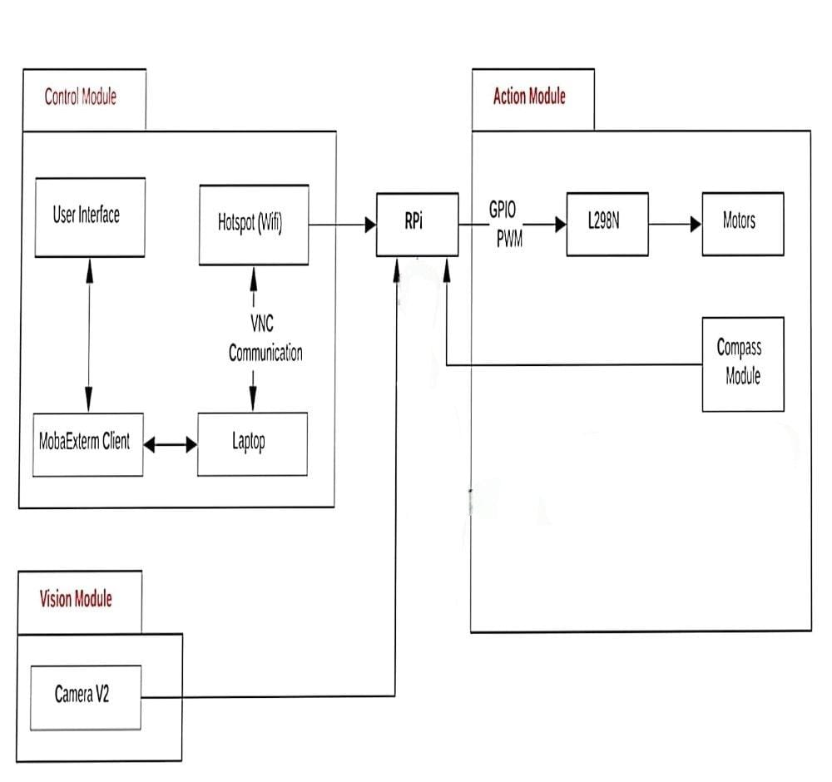
Environment
System central diagram

Slide 22
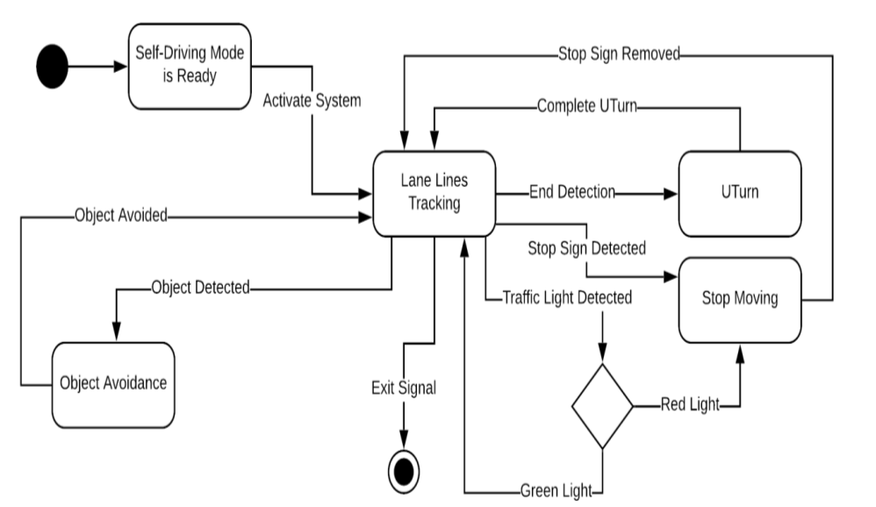
State Diagrams

Slide 23
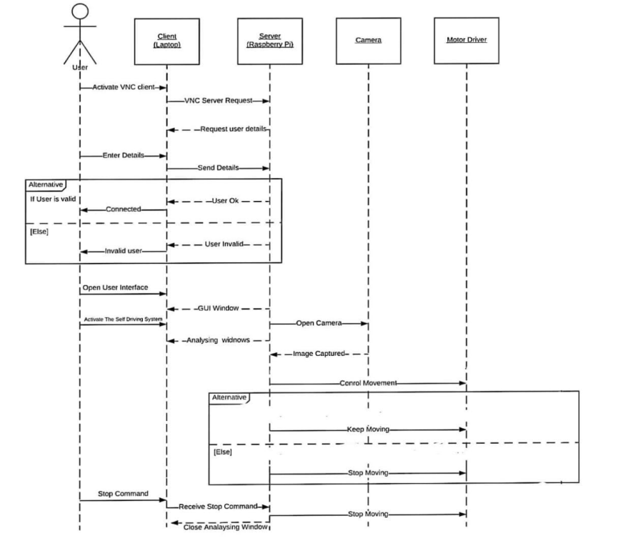
Sequence Diagrams

Slide 24
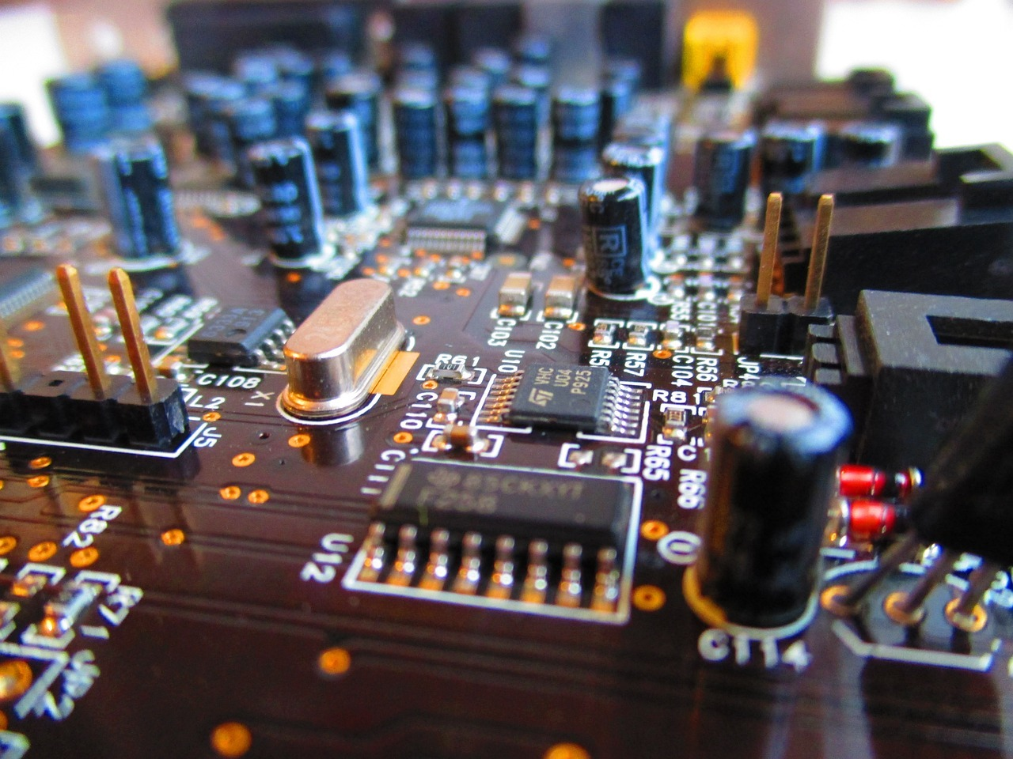
Implementation
03

Slide 25

Implementation
Using the open-source computational hardware and software, we can build a complete system that uses the computer vision algorithm to solve complicated tasks

Slide 26
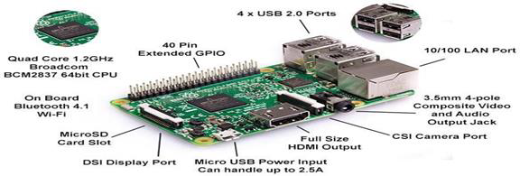
Raspberry pi
produced a whole generation of skilled programmers

Slide 27

camera
The Raspberry Pi Camera v2 is a high quality 8-megapixel Sony IMX219 image sensor custom

Slide 28
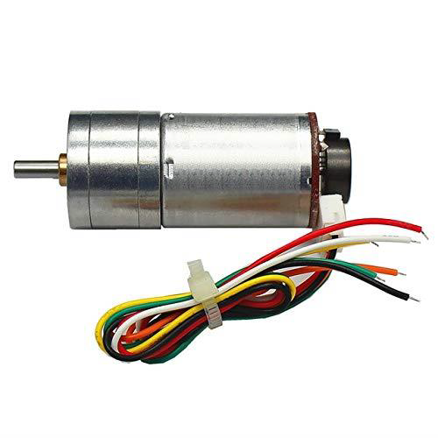
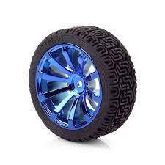
DC Gear Motor with encoder
Voltage: DC 12V
• Power: 3W
• Speed: 200RPM

Slide 29
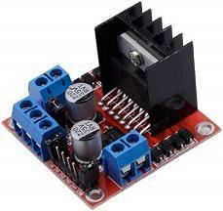
L298N Motor Driver

Slide 30
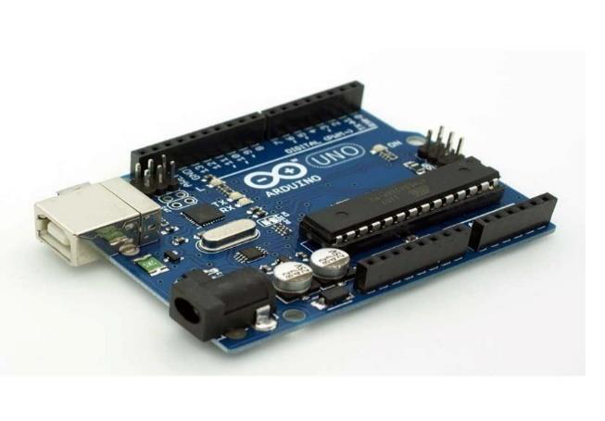
Arduino uno

Slide 31

Power Bank (10,000 mAh)
USB power banks are capable of powering a Raspberry Pi and a camera module since they usually have an output voltage of 5 V.

Slide 32
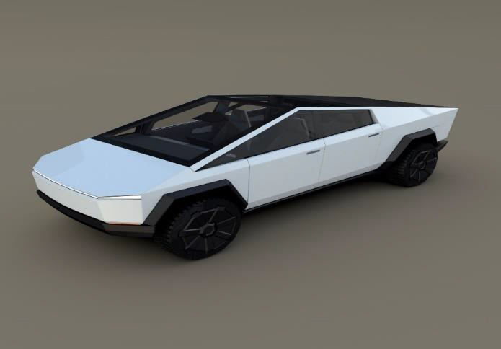
Tesla cyber truck
We use 3d printing technology

Slide 33
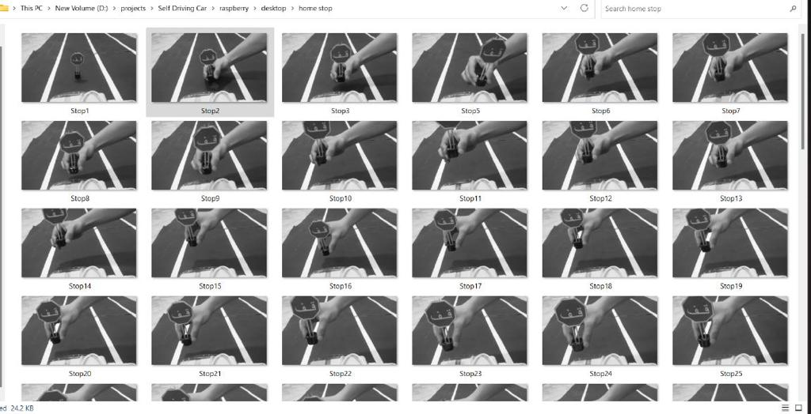
Trainnign and Testing
04

Slide 34
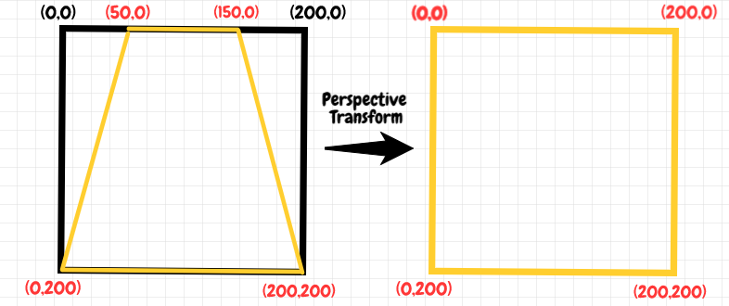
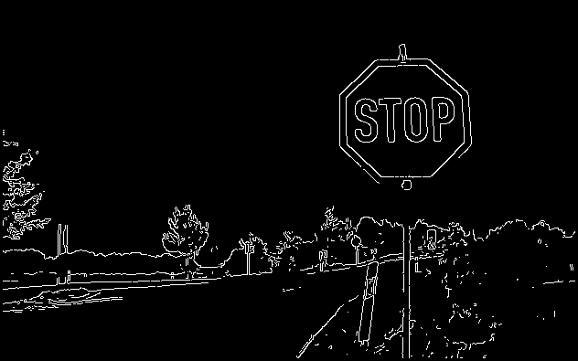

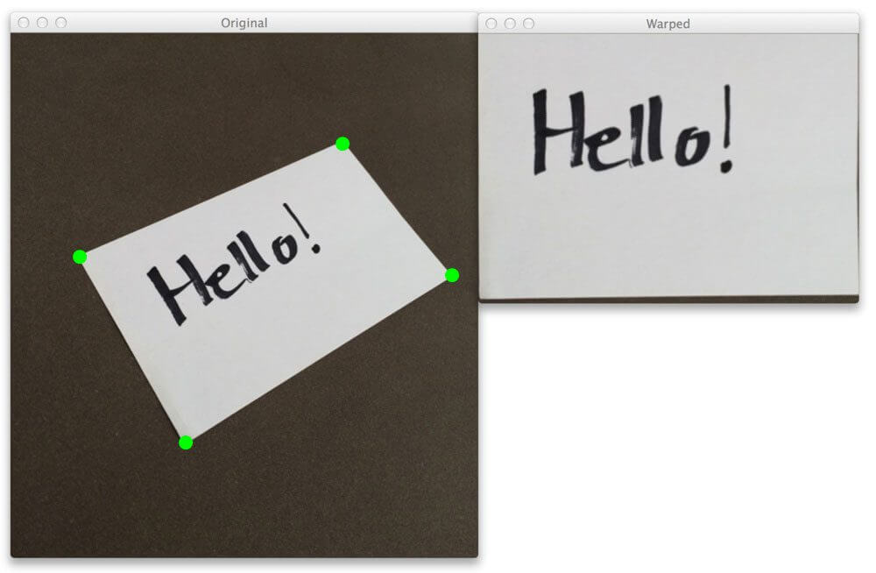
Image Processing Functions
Perspective function
Threshold & Canny
Histogram

Slide 35
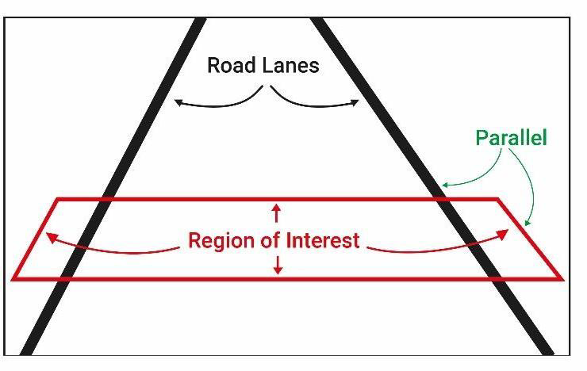
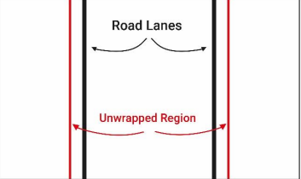
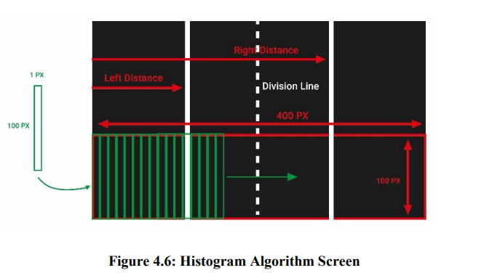

Cascade Training GUI software Lane Detection

Slide 36
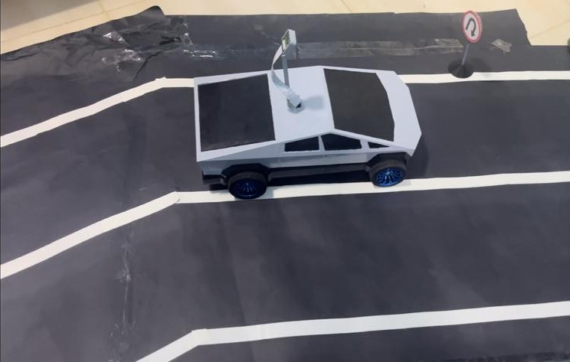
U-Turn Sign
The U-Turn system follows the same method for all shapes and objects. It depends on a cascade training file.

Slide 37
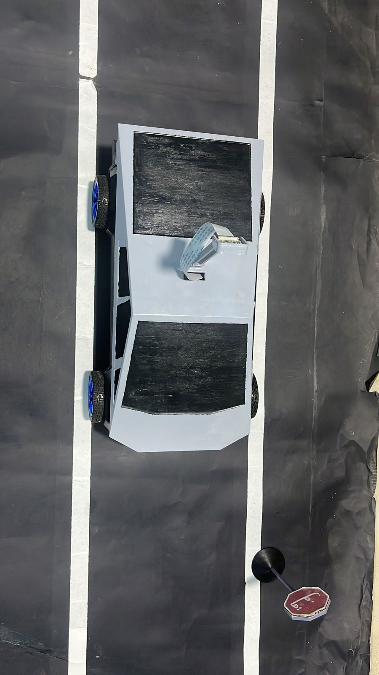
Detection
Car in front of the stop

Slide 38
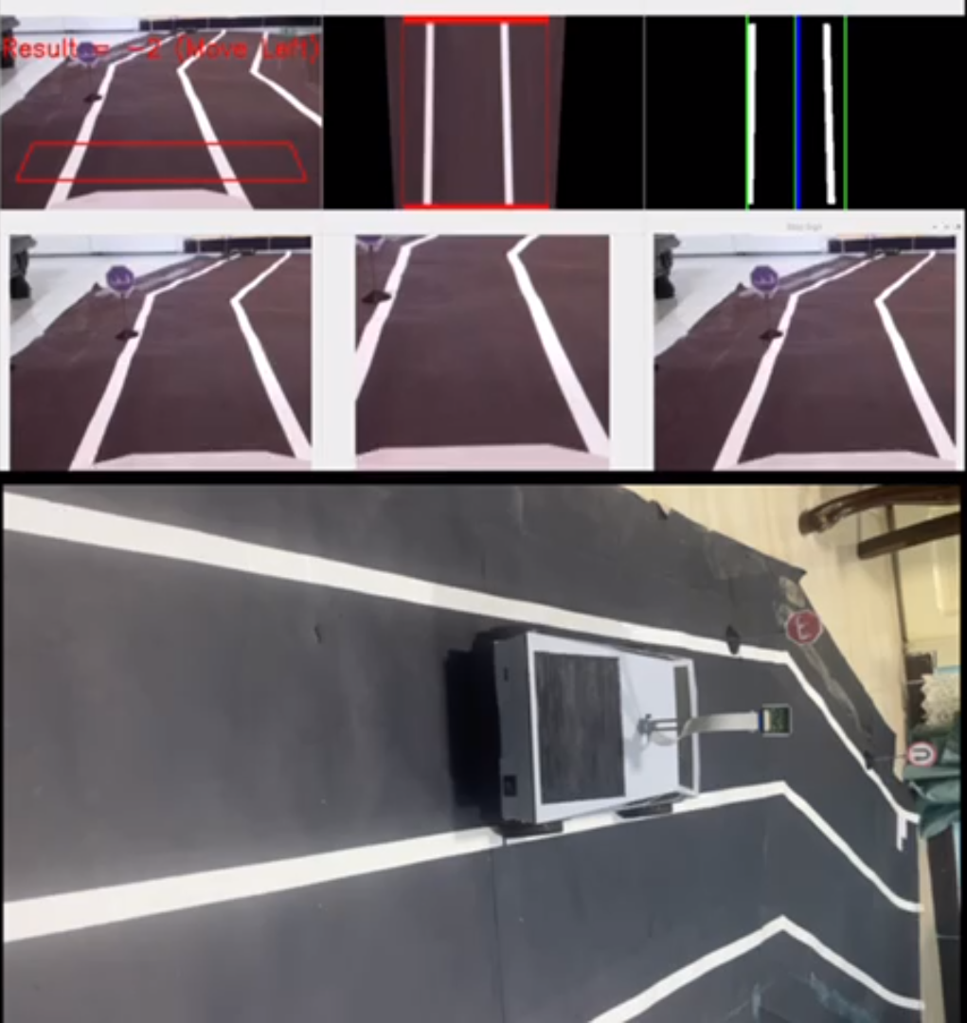
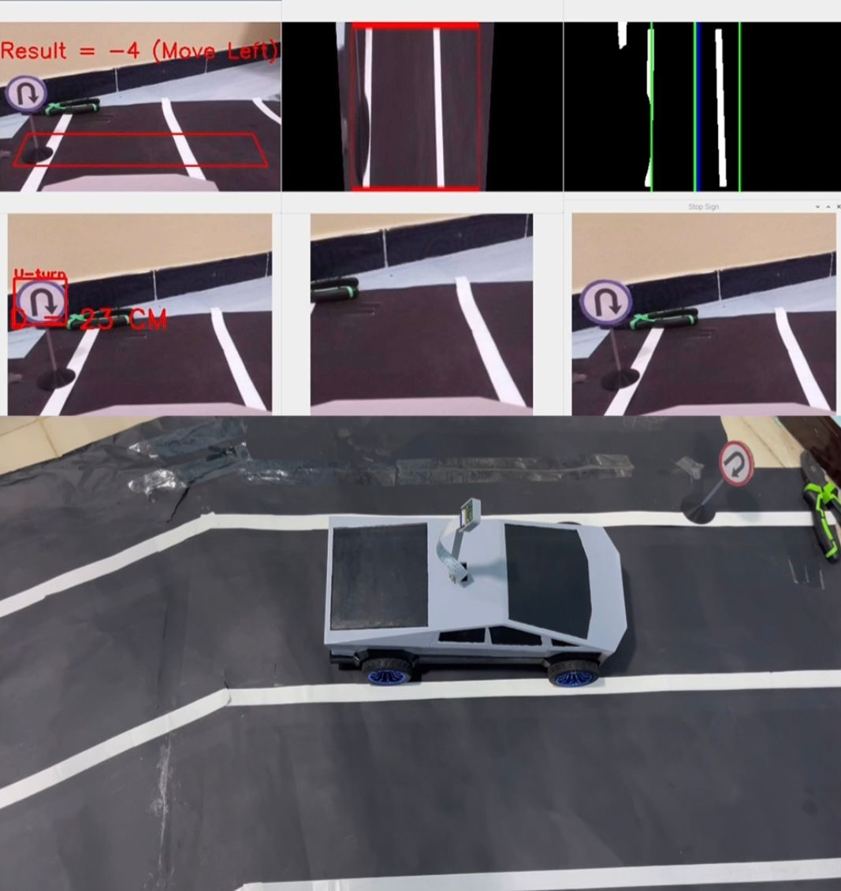
Testing
Test 1 (Lane Detecting and Tracking)
Test 2 (U Turn)

Slide 39
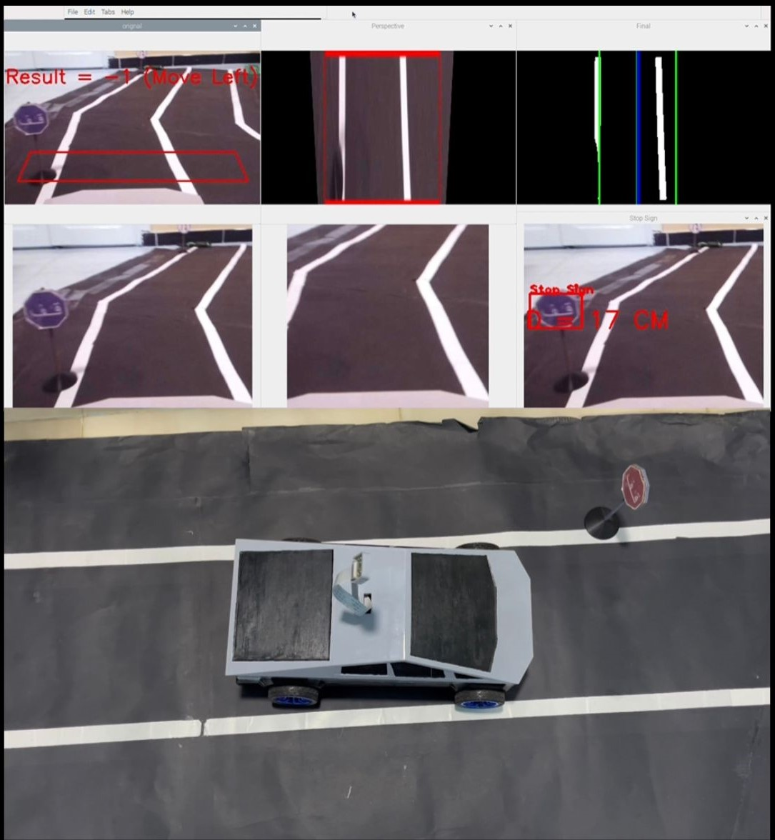
Test 3 (Stop Sign Detection and Function)

Slide 40
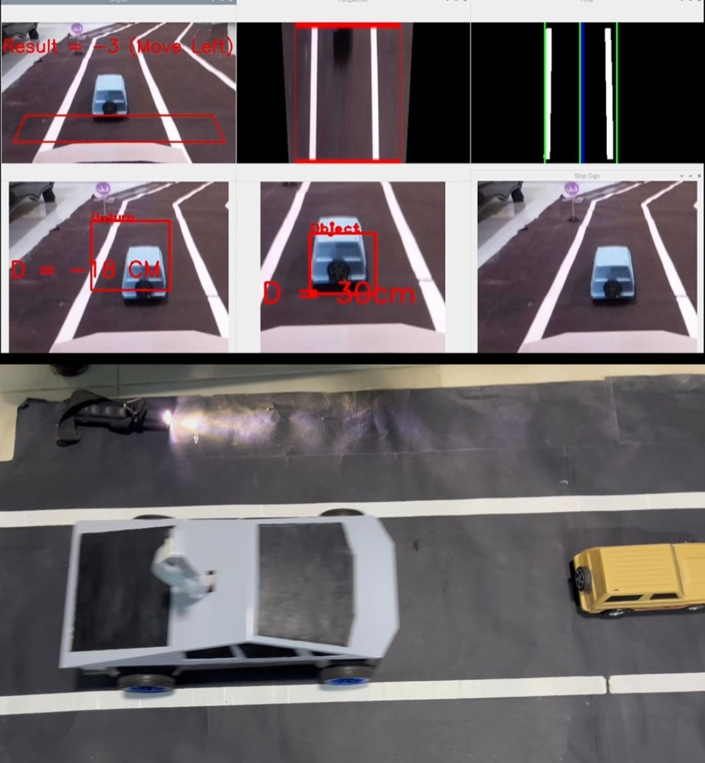
Test 4 (Object Avoidance)

Slide 41
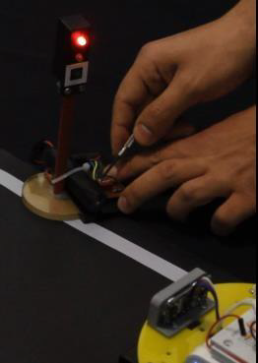
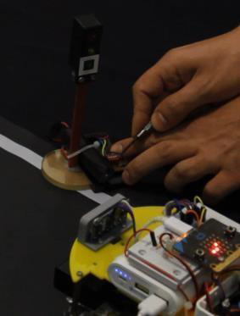
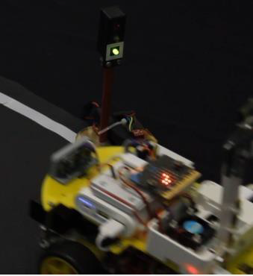
Test 5 (Traffic Light Detecting)

Slide 42
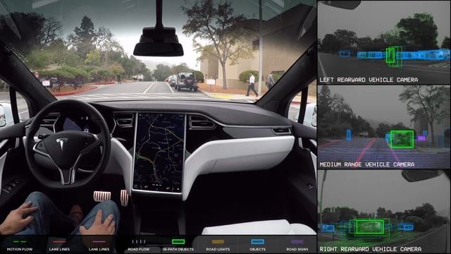
Results and Future Work
05

Slide 43
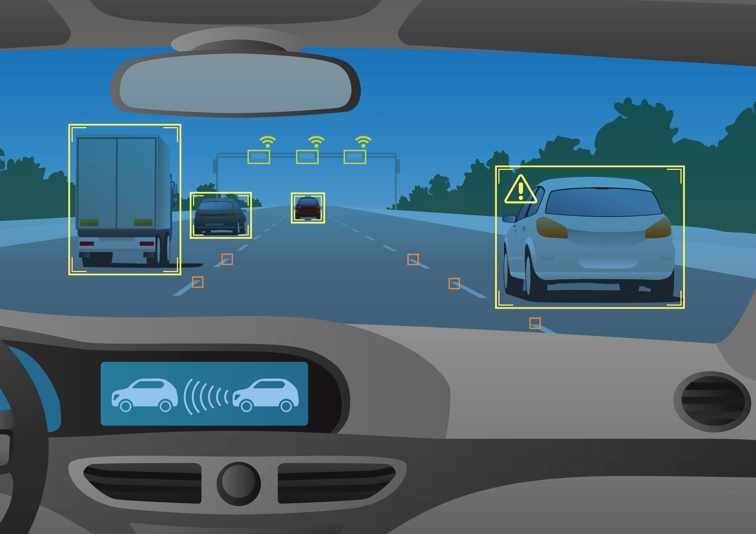
Advantages
Eradicating human error
More independence for the elderly and those with disabilities
Fewer accidents or deaths

Slide 44
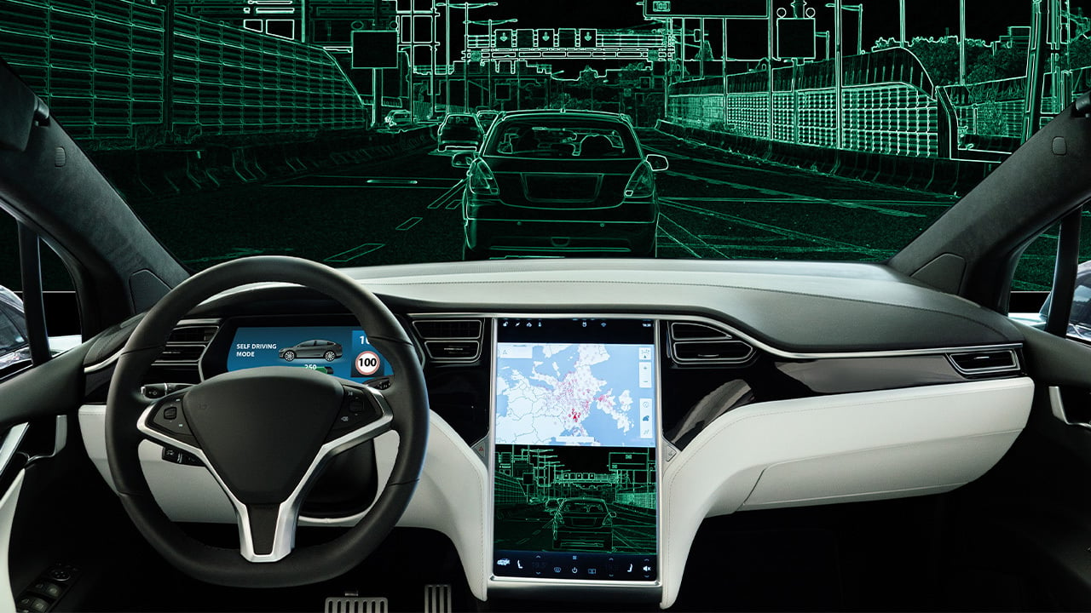
Advantages
Say goodbye to road rage.
• Opportunities for more efficient driving. ...
• Forgotten driving skills. ...
The danger of hacking. ...
Risk of accidents and death

Slide 45
Limitations
Security issues
Rise In Unemployment
High Cost Of Vehicles
Unlearn How To Drive Manually
Weather issues
Misunderstanding

Slide 46
Future Work

Slide 47
—
To conclude, we can say that this technology is getting closer to the customer every day, and the applications where the autonomous robot can be applied are increasing in all the fields.
Conclusion

Slide 48
THANK YOU!
Questions

